Slide 1
PART THREE
System Explanation

Slide 2
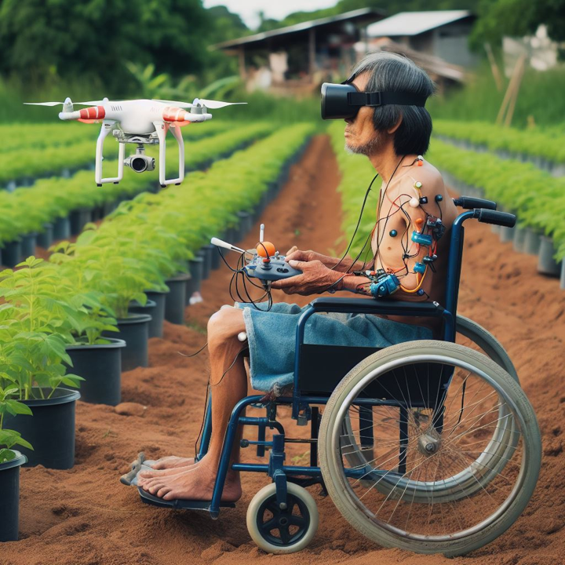
Aim of the System
01
Reducing Inequality
02
Promote Agricultural Production Efficiency
03
Protecting the health of people with disabilities
Notes:
Reducing Inequality: By leveraging advancements in drone AI and EMG sensors, the system seeks to expand the variety of jobs accessible to people with disabilities.
Promote agricultural production efficiency: Disabled people can participate in agricultural production by controlling drones and other technologies, which can improve agricultural production efficiency, increase food supply, and help reduce hunger problems
Protecting the health of people with disabilities: Low-cost EMG sensors allow more people with disabilities in the third world to protect their lives and health

Slide 3
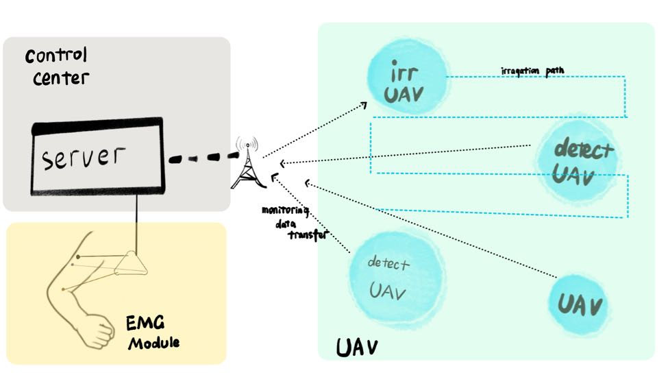
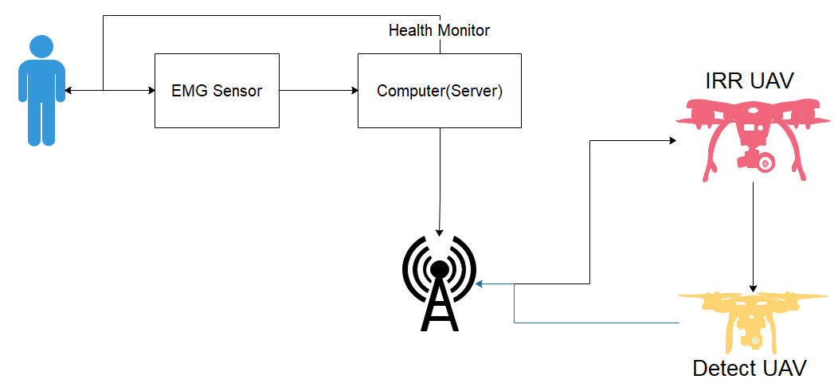
Function and Block Diagram of the System
Function of the System
Overall Block Diagram

